Slide 1
The role of serotonin in depression and antidepressant response
Chinenye Izuegbunam
April 3rd, 2020
Serotonergic Psychedelics

Slide 2
Theme
Serotonergic Psychedelics produce persistent antidepressant effects
Compare efficacy of psychedelics and ketamine as persistent antidepressant
Examine the effects of serotonin depletion
Antidepressants responses
Psychosocial stress
Depression

Slide 3
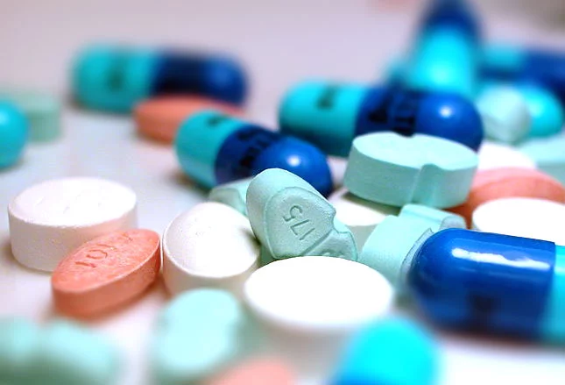
Characters
Major depressive disorder
Serotonin
Antidepressants (SSRIs and Ketamine)
Classic Psychedelics

Slide 4
Major depressive disorder (MDD)
Characterized by
depressed mood
loss of interest in daily activities for at least two weeks
impairs important functioning
E.g. social, occupational, educational
Affects millions of individuals globally.
~ 16.1 million American adults
~6.7% of the U.S. population age 18 and older in a year
More women than men

Slide 5
Treatment-resistant depression (TRD)

Slide 6
Severity of Major Depressive Episode Among U.S. Adolescents in 2017
SAMHSA 2017

Slide 7
Severity of Major Depressive Episode Among U.S. Adults in 2017
SAMHSA 2017

Slide 8
What have been done do combat this problem?
With monoamine hypothesis patients continue to experience
low remission rates
residual symptoms
relapses and overall functional impairment
Most antidepressants require chronic administration for long term effect

Slide 9
Serotonin (a neurotransmitter)
5-HT normal level
happy
calm
more focused
less anxious
more emotionally stable
5-HT depletion
depressed mood
low energy
Negative thoughts
crave sweets

Slide 10
Serotonin Biosynthesis

Slide 11
TPH2 mutant mice
A mutation in the TPH2 gene alters serotonin level
Mice lacking TPH2 display
Compulsive behaviour
Extreme aggressiveness
Autistic like behavioural traits

Slide 12
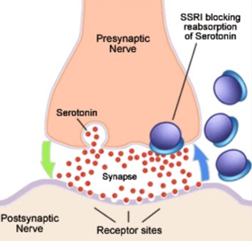
Selective-Serotonin-Reuptake Inhibitors (SSRIs)
Increase 5-HT synaptic levels
FDA approved
fluoxetine (Prozac)
citalopram (Celexa)
Paroxetine (Pexeva)
sertraline (Zoloft)

Slide 13
Classic Psychedelics (5-HT2A agonists)
Lysergic acid diethylamide (LSD)
Psilocybin (PSI)
Phase III clinical trial in USA
One or 2 acute treatment
Antidepressant effect (long term)
Anxiolytic effects

Slide 14
Ketamine
N-methyl-D-aspartate (NMDA) antagonist
Sedative and anesthetic
Rapid Relief of depression and suicidal ideation
Ketamine has also been used in cases of bipolar disorder
Chronic infusions are required for long term effects
Current side effect – hallucination, nausae
FDA approved for TRD treatment

Slide 15
Proposed mechanism of ketamine
Surge in glutamate release and cycling
Increased glutamatergic transmission through AMPA receptors
Increased BDNF
Increase synaptic density
Hippocampus
Medial prefrontal cortex
Antidepressant effect
Sanacora and Schatzberg (2015)

Slide 16
AV-101 from Vistagen therapeutics
Similar to ketamine
Trail ended October 19, 2019
https://www.vistagen.com/pipeline/av-101/major-depressive-disorder

Slide 17
Purpose
Importance of serotonin in depression treatment
Explore other routes to long term depression treatment

Slide 18
Hypothesis
5-HT2A based drugs are persistent antidepressants
Serotonin depletion causes behavioral phenotype indicative of depression in mice and impairs response to antidepressants.

Slide 19
So, what don’t we know (Objectives)
Does 5-HT depletion in mice lead to
A depression-like behavior?
Vulnerability to psychosocial stress?
Hindrance in antidepressant responses?
Is ketamine better or superior to psychedelics?

Slide 20
TPH2 -/- rat
A mutation in the TPH2 gene alters serotonin level
Rat lacking TPH2 display
Compulsive behaviour
Extreme aggressiveness
Autistic like behavioural traits

Slide 21
TPH2-/- does not display anhedonia (Inability to feel pleasure)

Slide 22
Learned helplessness (LH) paradigm
Initial shock training
Condition of helplessness

Slide 23
TPH2-/- mice show similar behavior to WT in LH test
NS – not exposed to foot shock
S – foot shocked

Slide 24
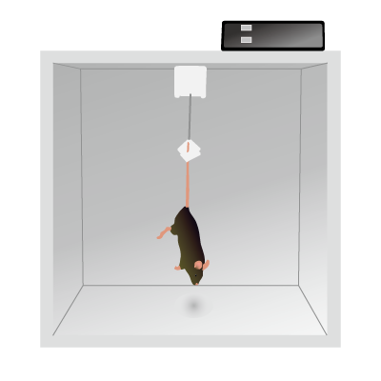
Tail-suspension test (TST)
Involves suspending mice above the ground by their tails
Lasts for six or more minutes.
Mice initially struggle to face upward and climb to a solid surface.
Longer periods of immobility are characteristic of a depressive-like state.

Slide 25
Forced swim test (FST)
Response to the threat of drowning
Interpreted as measuring susceptibility to negative mood.

Slide 26
TPH2-/- mice does not show depression-like phenotype
Notes:
Figure 2. Immobility times for TPH2−/− and wild-type control mice on the TST and FST. (A) TPH2−/− (KO) and wild-type controls (WT) have
the same immobility times in the TST. (B) KO mice spend significantly less time immobile than WT controls on the first trial of the FST but have
the same immobility times on the second trial. Immobility

Slide 27
TPH2−/− mice does not respond to Fluoxetine after TST
Notes:
TST after 30 mins of fluoxetine infusion

Slide 28
TPH2−/− mice does not respond to Paroxetine after TST
Notes:
Effects of SSRIs on immobility times in the TST for TPH2−/− and wild-type control mice

Slide 29
TPH2−/− mice does not respond to Citalopram after TST

Slide 30
Summary
Antidepressant effects of SSRIs are mediated by 5-HT
Brain 5HT depletion does not lead to a depression-like behavioral phenotype in mice.

Slide 31
5-HT depletion in stress susceptibility and its impact on antidepressant response?
Psychosocial stress results from
cognitive appraisal of what is at stake
what can be done about it.
when we look at a perceived threat in our lives.
Notes:
Does 5HT lead to or depression or does its depletion make us more susceptible to stress?

Slide 32
Approach to test Psychosocial stress
To mimic psychosocial stress:
Social defeat stress (SDS) paradigm
Experimental mice exposed to aggressive mice
Experimental mice physically defeated
Housed separately
Social avoidance testing
Open field
Container with aggressor and empty container
Social interaction with 20-cm–dimeter was measured

Slide 33
SDS Induced social avoidance in TPH2KI. TPH2KI rat is more susceptible to SDS
Notes:
SDS – social defeat stress
Prior research has shown that SDS can lead to a long-lasting
behavioral avoidance phenotype, which can be reversed by chronic
administration of antidepressants, such as fluoxetine (FLX)

Slide 34
Chronic Fluoxetine infusion following SDS. Can SSRI reverse stress-induced social avoidance?
Notes:
Chronic FLX admisyration for 3 weeks to rat exposec to 10 days SDS. It increased social preference in wildtype and not tph2

Slide 35
Summary
5-HT depletion increase vulnerability to psychosocial stress
Chronic FLX could not reverse stress-induced social avoidance in TPH2KI mice
5-HT deficiency impacts antidepressant response following stress

Slide 36
Single infusion of Psilocybin in WKY rats
Single infusion observed every week for 5 weeks
Reduced immobility rate in rPSI during FST
May last beyond 5 weeks

Slide 37
Long lasting antidepression effects
Notes:
LSD (n = 6) rats were
significantly less immobile in the FST 5 weeks following LSD
(p < 0.05) treatment, due to increased swimming (p < 0.05)
and climbing (p < 0.05) when compared to saline (SAL, n = 6)
rats (Figure 2C).

Slide 38
Transient depression alleviation after FST

Slide 39
Ketamine gives Rapid antidepression effect

Slide 40
Psychedelics gives long lasting antidepression effects
Notes:
Consistent results were observed in our final
experiment, where psilocybin (PSI, n = 6) rats were
significantly less immobile than saline (SAL, n = 6) rats at 1
week (p < 0.0001) and 5 weeks (p < 0.001) following
psilocybin administration, due to increased swimming (p <
0.05 both weeks) (Figure 2G). LSD (n = 6) rats were
significantly less immobile in the FST 5 weeks following LSD
(p < 0.05) treatment, due to increased swimming (p < 0.05)
and climbing (p < 0.05) when compared to saline (SAL, n = 6)
rats (Figure 2C).

Slide 41
Persistent antidepressant effect?

Slide 42
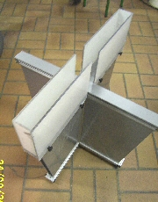
Elevated plus maze
A test for anxiety
EPM - two open arms and two enclosed arms
More time in
closed arm=anxiety-like
open arm= anxiolytic effect

Slide 43
rPSI group had sig. anxiolytic effect
Elevated plus maze

Slide 44
Elevated plus maze
No anxiolytic effect
Dose dependent? (0.1 mg/kg)

Slide 45
Elevated plus maze
Ketamine – No sig. anxiolytic effects (no reduction in anxiety)

Slide 46
Conclusion
Serotonin depletion does not necessarily lead to depression
5-HT deficiency impacts antidepressant response
Ketamine is an efficacious but transient antidepressant
Psychedelics seems to be the major drugs for persistent antidepressant effect as it is superior to ketamine
More studies are required to better understand the glutamate system

Slide 47
What do you think?
Can psychedelics be used on TPH2KO and TPH2KI rats to determine its effects?
What could be the effects of high dose of ketamine?
Does Ketamine have high addiction potential compared to psychedelics due to repeated infusion?
What might be the effect of ketamine/SSRIs and ketamine/psychedelics combination?

Slide 48
THANK YOU

